Slide 1

Flipkart-smartphones offers
A project by : Rawad Okla

Slide 2

Introduction
This data is about different smartphones sold on Flipkart website, with its specs, prices( before and after offers ), reviews & ratings and warranty
In this presentation we will ask a couple of questions that can help us draw a conclusion about the best and worst products on the website

Slide 3
Challenges
1. The dataset has entries of the same phone with different colours , at first it seems as a duplicate. But those are the same variants of the phone, but sold by different vendors and it has different ratings and prices . So we will deal with it as it is different phones
2. We can’t compare phones by processor or cameras as it will need in depth review and data (which are not provided in this one) so we will only compare numerical data ( numbers of rates, batteries and pricing)

Slide 4
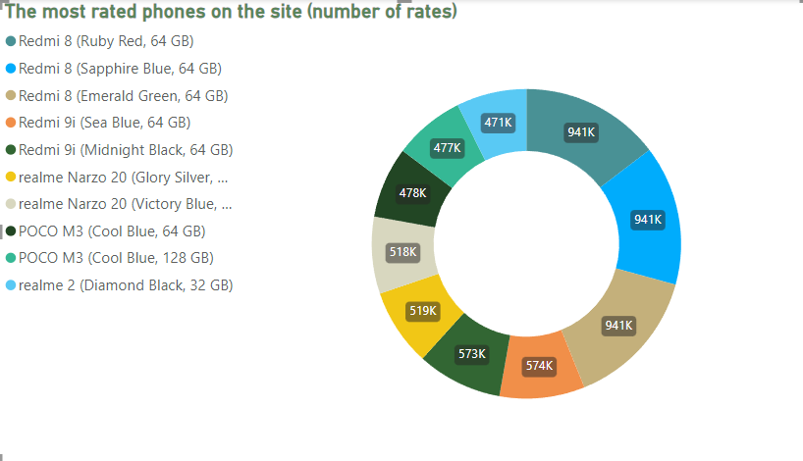
What are the smartphones with the least number of ratings

Slide 5
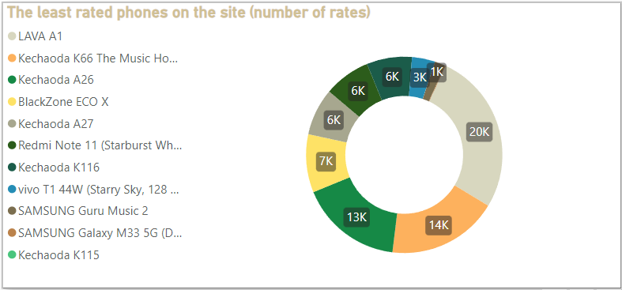
What are the smartphones with the highest number of ratings

Slide 6
What are the smartphones with the highest number of ratings

Slide 7
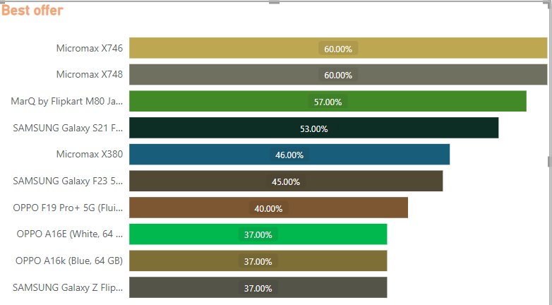
What are the smartphones with the best offer

Slide 8
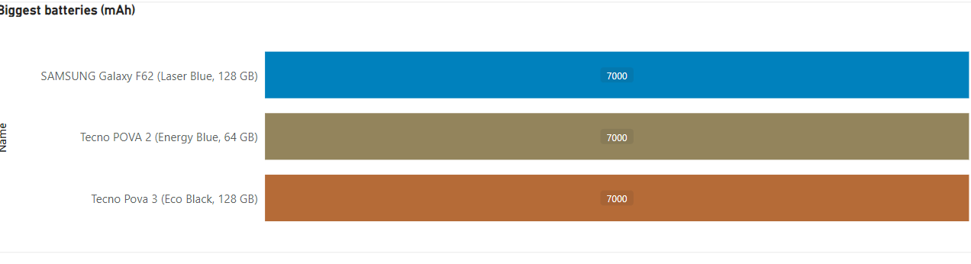
What are the smartphones with the biggest battery capacity

Slide 9
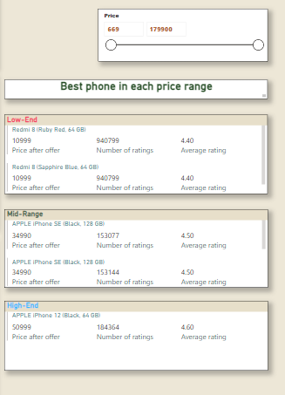
What are the best smartphone in each pricing category

Slide 10
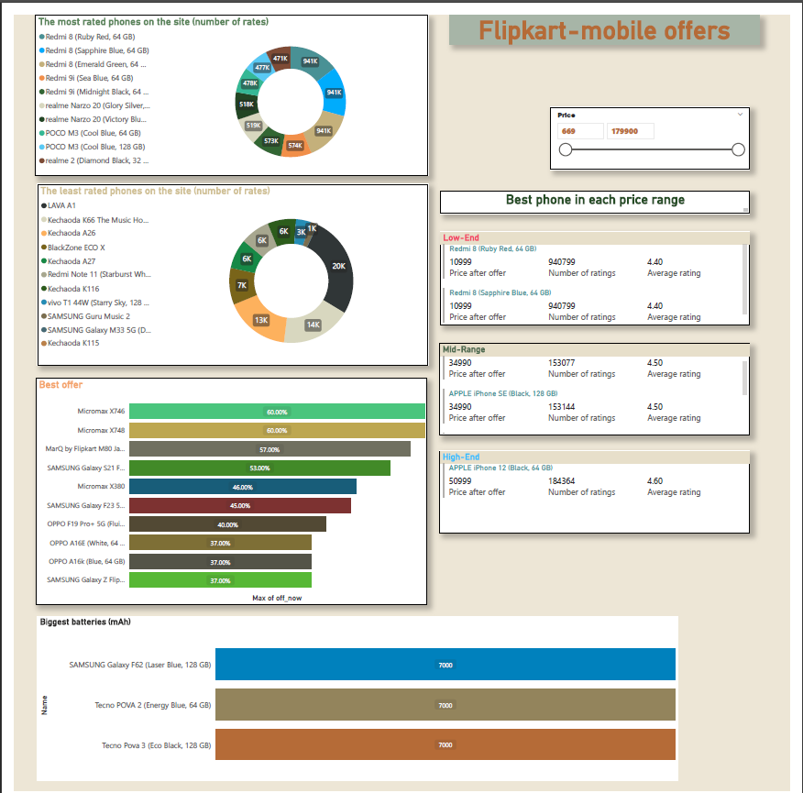
Overall view

Slide 11
Conclusion
In the end smartphones are personal preference, but data can help make the best decision according to personal usage , design and price.

